Slide 1


AI Powered Game
Project Presentation On
(21AIP76)
Student Name | : | B M Nithish Kumar, Chaithu A, Chinmayee N Holla, Nuthan K Gowda
USN | : | 1JT21AI008, 1JT21AI009, 1JT21AI011, 1JT21AI028
Semester | : | VIII
Department | : | Artificial Intelligence and Machine Learning
Academic Year Guide | : : | 2024-2025 Mrs. Deepthi Das V (Assistant Professor)
Department of Artificial Intelligence and Machine Learning Engineering, JIT
‹#›

Slide 2
Institution Vision & Mission
Vision of the Institution:
To be an institution of excellence in Engineering education, Innovation and Research and work towards evolving great leaders for the country’s future and meeting global needs.
Mission of the Institution:
The Institution aims at providing a vibrant, intellectually and emotionally rich teaching learning environment with state of art infrastructure and recognizing and nurturing the potential of each individual to evolve into one’s own self and contribute to the welfare of all.
Department of Artificial Intelligence and Machine Learning Engineering, JIT

Slide 3
Department of AIML Vision & Mission
Vision of the department:
To transform students into responsible citizens and competent professionals by creating environment conductive to disseminate the knowledge in the area of Artificial Intelligence and Machine Learning
Mission of the department:
To provide an environment suitable to innovation, creativity and team-spirit.
To practice and promote high standards of professional ethics and transparency.
To impart quality education to the students and promote research in the field of Artificial Intelligence and Machine Learning.
To create professionals with leadership qualities to provide sustainable solutions to address global problems.
Department of Artificial Intelligence and Machine Learning Engineering, JIT

Slide 4

OUTLINE
Literature Survey
Problem Statement
Hardware & Software Requirements
Functional Requirements
Non-functional Requirements
Innovative Dialogue system
Full Project Implementation
System Testing & Evaluation
Results
Project Limitations
Future Work & Enhancements
Conclusion
References
29/05/2025

Slide 5

LITERATURE SURVEY
In AI-powered game development, ensuring safety and ethical interactions is crucial. This literature survey reviews two key research papers that discuss AI safeguards in human-AI interactions and ethical considerations in game AI.
Paper Title & Authors | Key Insights | Relevance to Our Project
Llama Guard: LLM-based Input-Output Safeguard for Human-AI Conversations (Inan et al., 2023) | Introduces Llama Guard, a safety system that classifies and filters AI-generated text to prevent harmful content | Helps ensure safe AI dialogues in games by preventing inappropriate AI responses.
The Ethics of AI in Games (IEEE Paper, 2023) | Discusses ethical challenges of AI in games, including biased decision-making, player manipulation, and AI-driven content generation. | Guides responsible AI design in games to ensure fairness, safety, and player trust.
29/05/2025

Slide 6
LITERATURE SURVEY
Llama Guard Integration:
Uses real-time safety filtering to monitor and moderate AI-generated dialogues.
Ensures NPC responses remain appropriate by blocking harmful, offensive, or misleading content.
Prevents unsafe interactions by detecting and filtering risky prompts in conversations.
Ethical AI Implementation:
Ensures AI-driven NPCs and game mechanics follow ethical guidelines to avoid bias.
Prevents unfair AI decision-making that could disadvantage certain players.
Ensures procedural content generation and AI interactions do not reinforce stereotypes or discrimination.
Player Interaction Safety:
AI respects player choices and autonomy without manipulation.
Prevents AI-driven mechanics from pressuring players into unnecessary purchases or actions
Ensures AI assistants and NPCs provide balanced, fair, and transparent guidance.
29/05/2025

Slide 7
PROBLEM STATEMENT
Modern players demand immersive gameplay. Traditional NPCs are static and limited in interactions. Our project, building on technologies like Interactive LLM Powered NPCs, aims to make NPCs truly intelligent and emotionally responsive, bridging the gap between player expectation and static storytelling.
29/05/2025

Slide 8
HARDWARE AND SOFTWARE REQUIREMENTS
Processor (CPU) Minimum: Quad-core CPU (e.g., Intel i5 or AMD Ryzen 5) Recommended: 6-core or higher for faster processing and multitasking
Graphics Card (GPU) Minimum: NVIDIA GTX 1060 / AMD Radeon RX 580 Recommended: NVIDIA RTX 3060 or higher (for faster facial animation and LLM inference)
RAM (Memory) Minimum: 16 GB Recommended: 32 GB (especially when running game + model simultaneously)
Dual Monitor Setup Recommended for smoother interaction — one for the game, one for the LLM interface
Cohere for LLM dialogue
SadTalker for lip-sync facial animations
DeepFace for face recognition and emotion detection
Edge-TTS for speech synthesis
ChromaDB for vector stores (NPC memory)
29/05/2025

Slide 9
FUNCTIONAL REQUIREMENTS
Voice Input Players speak to NPCs using a microphone. The system captures and converts this voice into text using speech recognition.
NPC Identification via Facial Recognition The system uses facial recognition to identify which NPC the player is talking to — even distinguishing between main and background characters.
LLM-Driven Response Generation The captured dialogue is sent to a Large Language Model (LLM), which generates a reply based on:
Game world context stored in vector databases
Character-specific knowledge and backstory
Predefined speech patterns
Speech and Facial Animation The LLM's reply is turned into speech using text-to-speech (TTS). Simultaneously, SadTalker generates a video of the NPC’s face speaking the line, using their facial image.
In-Game Integration The system replaces the on-screen face pixels with the generated video, making it appear as if the NPC is actually talking.
29/05/2025

Slide 10
INNOVATIVE NPC DIALOGUE SYSTEM
Transforms Any NPC into a Conversational AI Brings life to previously silent or static NPCs, allowing dynamic, intelligent conversations.
Supports Interaction During Any Gameplay Phase Talk to NPCs seamlessly while:
Exploring the world
Engaging in combat
Riding, driving, or moving through the game
Emotion-Aware NPC Responses NPCs read your facial expressions through your webcam and adjust their responses to match your mood — making conversations feel more human.
Immersive Open-World Integration Deepens player engagement by making the game world feel alive and responsive.
Works Without Modifying Game Code Integrates visually — no need to access or alter the original game's source code.
29/05/2025

Slide 11
PROJECT IMPLEMENTATION
LLM-Driven Dialogue: Integrated a language model (LLM) to generate realistic, in-character NPC conversations.
Voice Interaction: Voice input is converted to text using speech-to-text (STT) services.
NPC Identity Detection: Facial recognition used to determine which NPC is being interacted with.
Context-Aware Replies:
Queries are enriched with game lore (via vector database).
Personalities are embedded from pre_conversation.json.
NPC Output:
LLM response converted back to voice via TTS.
SadTalker used for real-time lip-sync facial animation.
Dual Window Mode:
Animation rendered on a separate window or monitor.
Optional fallback for single-screen setups.
29/05/2025

Slide 12
TESTING & EVALUATION
Functional Testing:
Speech-to-text accuracy validated using various microphones and accents.
LLM responses tested against expected in-lore behaviors.
Emotion Detection:
Webcam input tested for real-time emotion classification.
NPC responses dynamically adjusted based on player emotion.
In-Game Interaction:
Verified smooth performance during exploration, combat, and travel scenarios.
29/05/2025

Slide 13
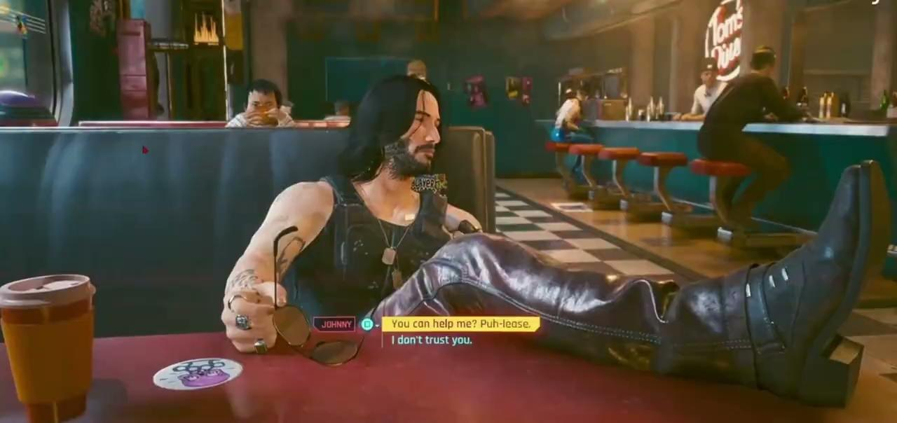
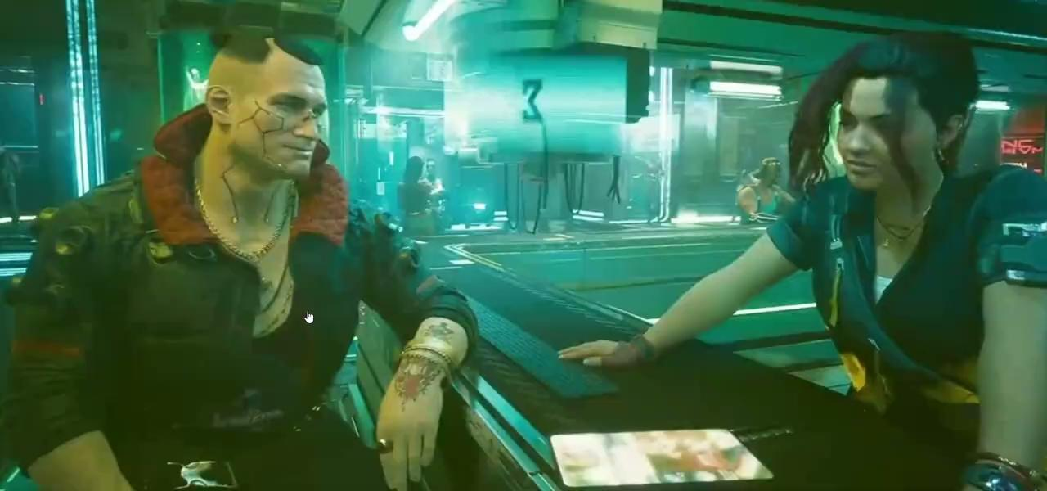
RESULTS
29/05/2025

Slide 14
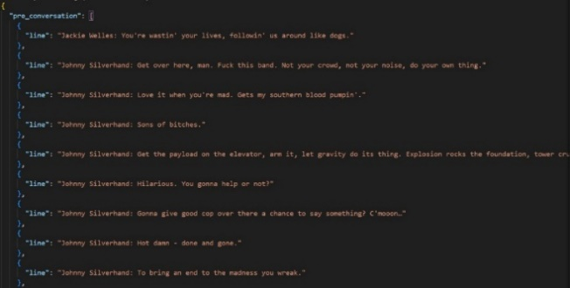
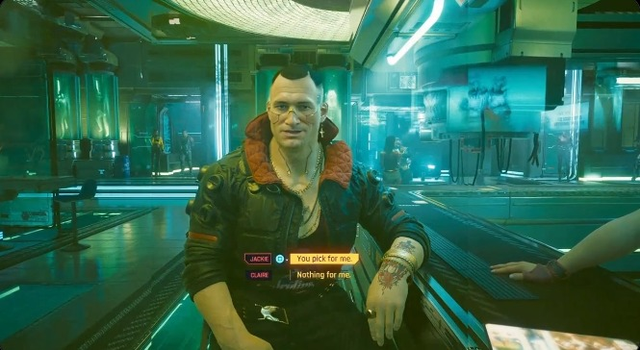
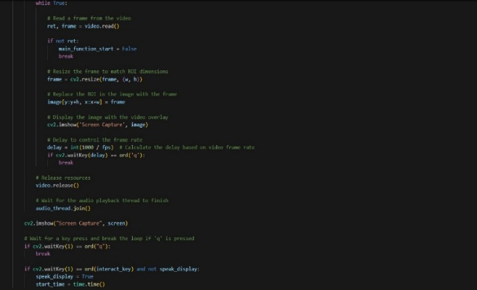
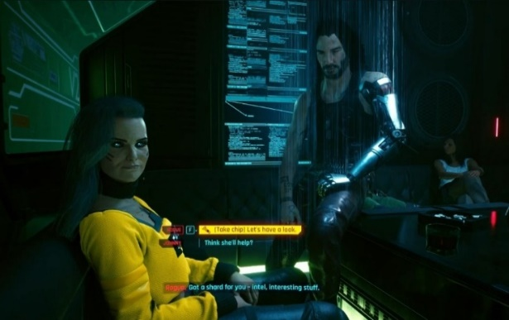
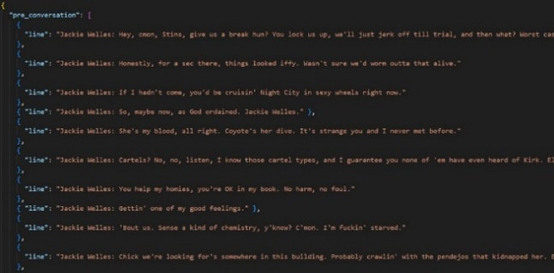

SCREENSHOTS
Fig 1: pre-conversation json Fig 2: character identification
Fig 3: main.py
Fig 4: pre-conversation json Fig 5: voice based interaction
Fig 6: emotion recognition
29/05/2025

Slide 15
PROJECT LIMITATIONS
High Resource Demand:
Requires powerful GPU for smooth animation rendering.
Latency:
LLM + TTS + SadTalker pipeline introduces slight delay in responses.
Dependence on Internet:
Real-time LLM generation and emotion recognition depend on online APIs.
Emotion Misclassification:
Real-time emotion detection may misinterpret facial expressions in low-light or noisy backgrounds.
Monitor Dependency:
Best experience requires a secondary monitor or workaround setup
29/05/2025

Slide 16
FUTURE WORK & ENHANCEMENTS
Lightweight Models:
Replace LLM with distilled or on-device models for offline support.
Multi-NPC Conversations:
Enable dynamic group dialogues with multiple NPCs reacting simultaneously.
Memory & Continuity:
Introduce long-term memory to allow NPCs to remember past interactions.
Improved Facial Animation:
Upgrade to real-time 3D character animation for more realistic expression.
Modular Integration Tools:
Develop a plug-and-play SDK for easier integration into existing games (especially for modding communities).
29/05/2025

Slide 17
CONCLUSION
This project demonstrates a novel approach to NPC interaction by integrating Large Language Models with real-time voice, facial animation, and emotion recognition.
It successfully transforms static NPCs into dynamic, conversational agents that enhance immersion and emotional engagement in gameplay.
The modular design allows it to be retrofitted into existing games, even without access to source code.
With further optimization, this system could serve as a foundation for next-generation AI-driven gaming experiences, pushing the boundaries of interactive storytelling.
29/05/2025

Slide 18
REFERENCES
[1] https://learn.deeplearning.ai/courses/building-an-ai-powered-game/yc1wq/introduction
[2] https://arxiv.org/abs/2312.06674
[3] https://ieeexplore.ieee.org/document/10125072
[4] https://github.com/OpenTalker/SadTalker
[5] https://docs.cohere.com/reference/about
Link to drive: AI_Powered_Game_Videos
29/05/2025

Slide 19
THANK YOU
29/05/2025

